Slide 1
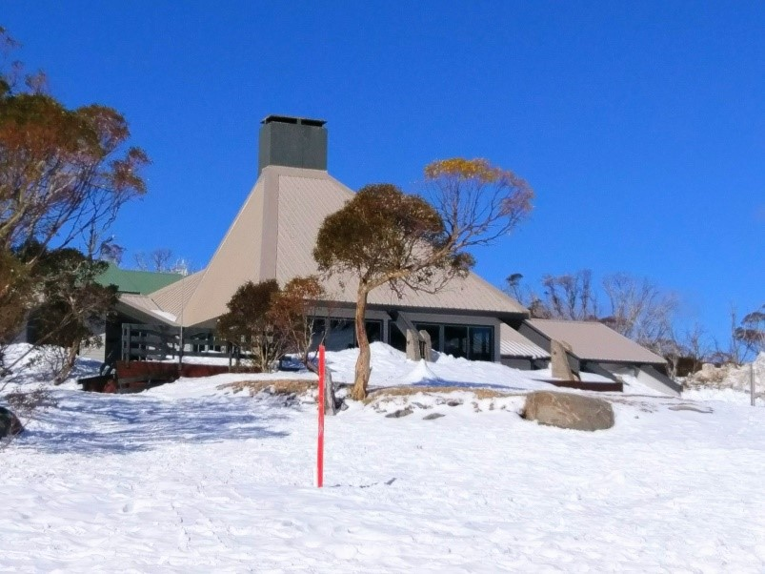
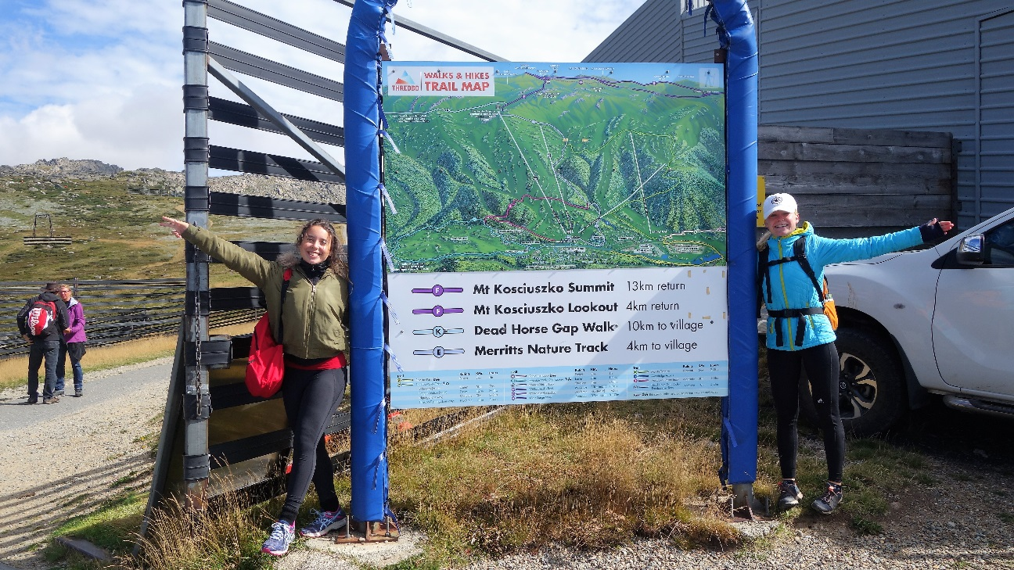
TOP OF AUSTRALIA TOUR 1-5 March 2018

Slide 2
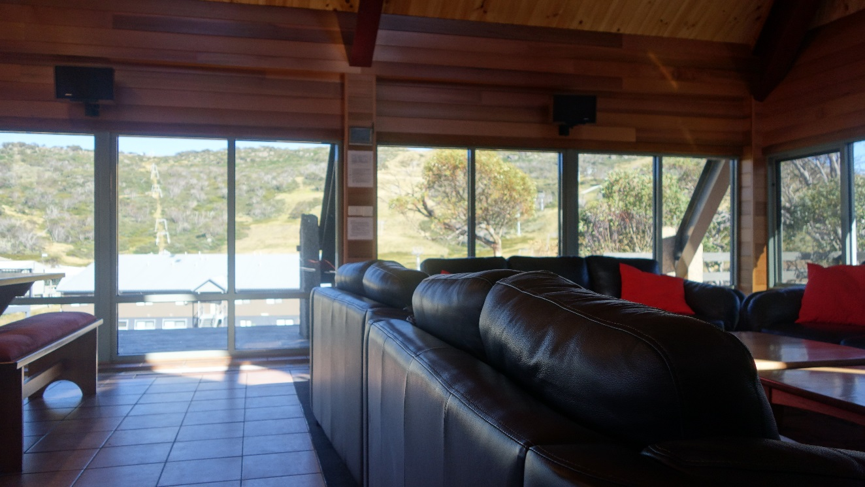
The Lodge

Slide 3
The Starters

Slide 4
The Starters

Slide 5
The Starters

Slide 6
Thredbo Mt Kosciuszko

Slide 7
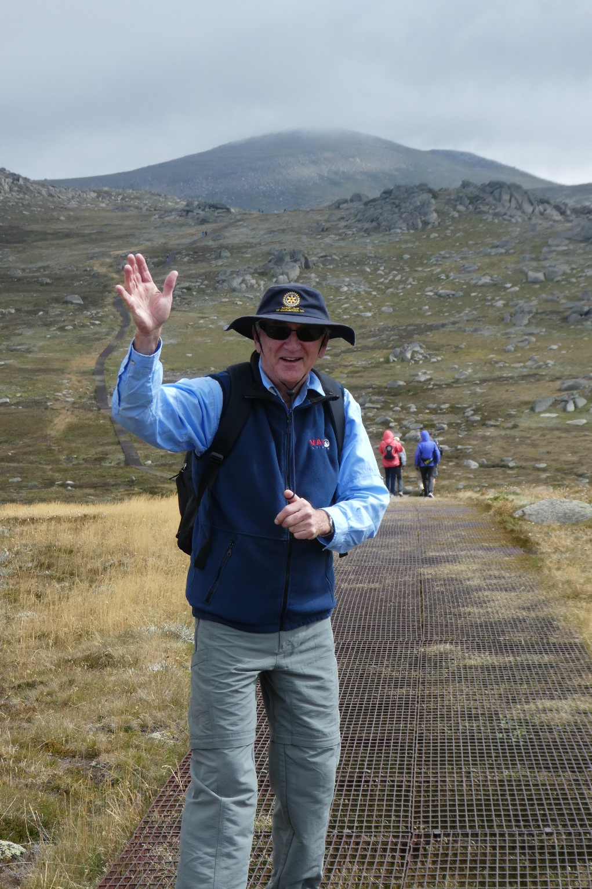
Thredbo Mt Kosciuszko

Slide 8
Thredbo Mt Kosciuszko

Slide 9
Thredbo Mt Kosciuszko

Slide 10
Thredbo Mt Kosciuszko

Slide 11
Thredbo Mt Kosciuszko

Slide 12
Mt Kosciuszko at the Top

Slide 13
Mt Kosciuszko at the Top

Slide 14
Mt Kosciuszko First Casualty

Slide 15
Thredbo Mt Kosciuszko

Slide 16
Mt Kosciuszko at the Top

Slide 17
Thredbo Mt Kosciuszko

Slide 18
Thredbo Mt Kosciuszko

Slide 19
Thredbo Mt Kosciuszko

Slide 20
Charlotte Pass

Slide 21
Charlotte Pass

Slide 22
Charlotte Pass

Slide 23
Charlotte Pass

Slide 24
Charlotte Pass

Slide 25
Charlotte Pass

Slide 26
Charlotte Pass

Slide 27
Perisher Valley Porcupine Rocks

Slide 28
Perisher Valley Porcupine Rocks

Slide 29
Perisher Valley Porcupine Rocks

